Slide 1

Parallel and Distributed Computing
Lecture – 01 Introduction

Slide 2
Background – Serial Computing
Computer software was written conventionally for serial computing.
Standard computing is also known as "serial computing"
This meant that to solve a problem, an algorithm divides the problem into smaller instructions.
These discrete instructions are then executed on the Central Processing Unit of a computer one by one.
Only after one instruction is finished, next one starts.

Slide 3
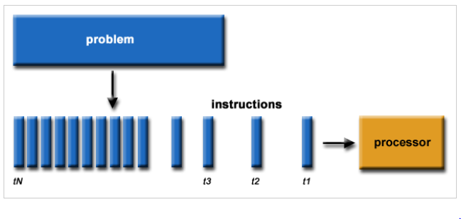
Background – Serial Computing
Traditionally, software has been written for serial computation:
A problem is broken into a discrete series of instructions
Instructions are executed sequentially one after another
Executed on a single processor
Only one instruction may execute at any moment in time
Serial computing generic example

Slide 4
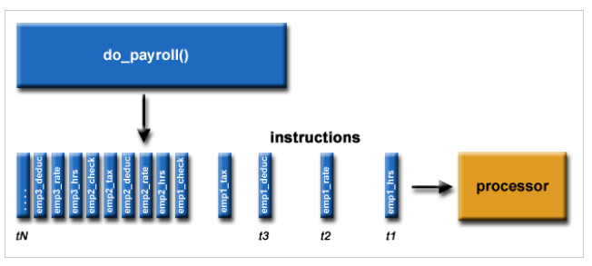
Background – Serial Computing
Serial computing example of processing payroll

Slide 5
Background – Serial Computing
A real-life example of this would be people standing in a queue waiting for a movie ticket and there is only a cashier. The cashier is giving tickets one by one to the persons. The complexity of this situation increases when there are 2 queues and only one cashier.
So, in short, Serial Computing is following:
In this, a problem statement is broken into discrete instructions.
Then the instructions are executed one by one.
Only one instruction is executed at any moment of time.

Slide 6
Background – Serial Computing
Look at point 3. This was causing a huge problem in the computing industry as only one instruction was getting executed at any moment of time. This was a huge waste of hardware resources as only one part of the hardware will be running for particular instruction and of time.
As problem statements were getting heavier and bulkier, so does the amount of time in execution of those statements. Examples of processors are Pentium 3 and Pentium 4.
Now let’s come back to our real-life problem. We could definitely say that complexity will decrease when there are 2 queues and 2 cashiers giving tickets to 2 persons simultaneously. This is an example of Parallel Computing.

Slide 7
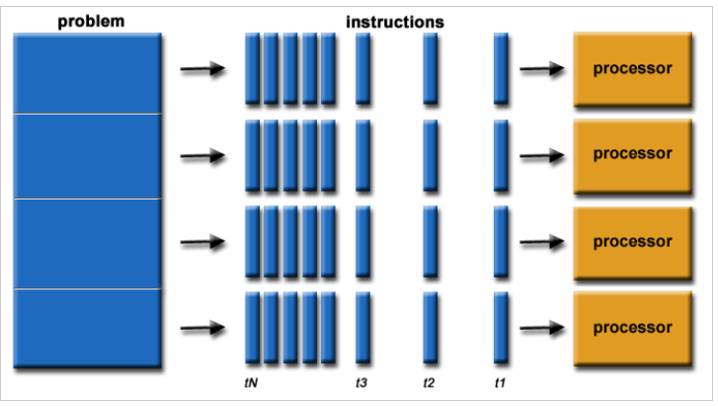
Parallel Computing
In the simplest sense, parallel computing is the simultaneous use of multiple compute resources to solve a computational problem:
A problem is broken into discrete parts that can be solved concurrently
Each part is further broken down to a series of instructions
Instructions from each part execute simultaneously on different processors
An overall control/coordination mechanism is employed
Parallel computing generic example

Slide 8
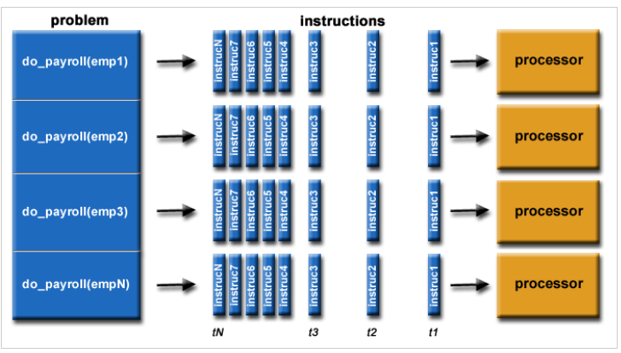
Parallel Computing
Parallel computing example of processing payroll

Slide 9
Parallel Computing
The computational problem should be able to:
Be broken apart into discrete pieces of work that can be solved simultaneously;
Execute multiple program instructions at any moment in time;
Be solved in less time with multiple compute resources than with a single compute resource.
The compute resources are typically:
A single computer with multiple processors/cores
An arbitrary number of such computers connected by a network

Slide 10
Parallel Computer
Virtually all stand-alone computers today are parallel from a hardware perspective:
- Multiple functional units (L1 cache, L2 cache, branch, prefetch, decode,
floating-point, graphics processing (GPU), integer, etc.)
Multiple execution units/cores
Multiple hardware threads

Slide 11
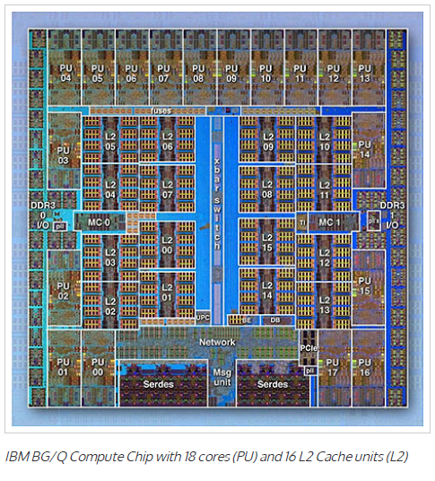
Parallel Computer

Slide 12
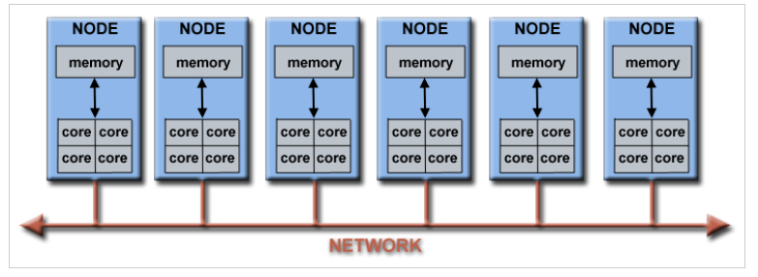
Parallel Computer
Networks connect multiple stand-alone computers (nodes) to make larger parallel computer clusters.

Slide 13
Parallel Computing
Kind of computing architecture where the large problems break into independent, smaller, usually similar parts that can be processed in one go.
It is done by multiple CPUs communicating via shared memory, which combines results upon completion.
It helps in performing large computations as it divides the large problem between more than one processor.

Slide 14
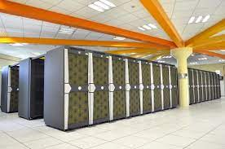
Parallel Computing
Parallel computing also helps in faster application processing and task resolution by increasing the available computation power of systems.
The parallel computing principles are used by most supercomputers employ to operate.
The operational scenarios that need massive processing power or computation, generally, parallel processing is commonly used there.

Slide 15
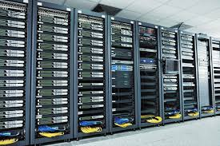
Parallel Computing
Typically, this infrastructure is housed where various processors are installed in a server rack; application server distributes the computational requests into small chunks then requests are processed simultaneously on each server.
The earliest computer software is written for serial computation as they are able to execute a single instruction at one time, but parallel computing is different where it executes several processors an application or computation in one time.

Slide 16
Parallel Computing – Flynn’s Taxonomy
There are several different ways to classify parallel computers. One of the more widely used classifications, in use since 1966, is called Flynn's Taxonomy.
Flynn's taxonomy distinguishes multi-processor computer architectures according to how they can be classified along the two independent dimensions of Instruction Stream (I) and Data Stream (D) . Each of these dimensions can have only one of two possible states: single (S) or multiple (M).
A sequence of instructions (the instruction stream) manipulates a sequence of operands (the data stream)

Slide 17
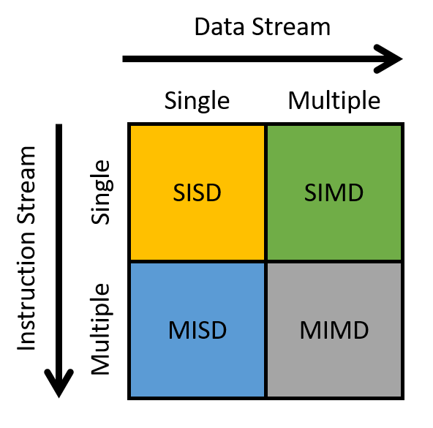
Parallel Computing – Flynn’s Taxonomy

Slide 18
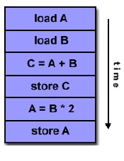
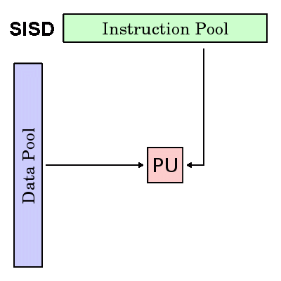
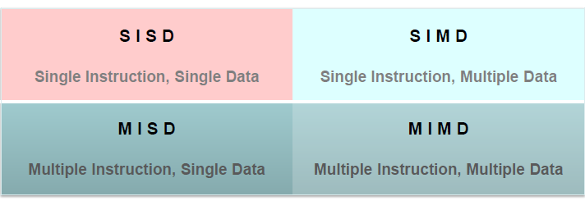
Parallel Computing – Flynn’s Taxonomy
A serial (non-parallel) computer
Single Instruction: Only one instruction stream is being acted on by the CPU during any one clock cycle
Single Data: Only one data stream is being used as input during any one clock cycle
Deterministic execution
This is the oldest type of computer
Single-CPU systems
i.e., uniprocessors
Note: co-processors don’t count as more processors
Examples: older generation main frames, workstations , PCs

Slide 19
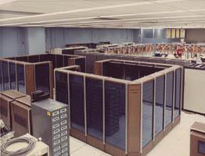
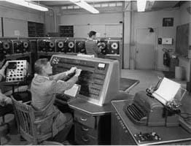
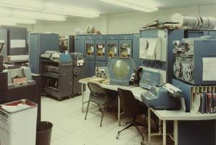
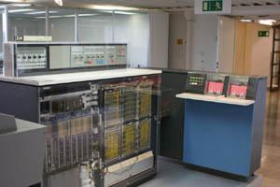
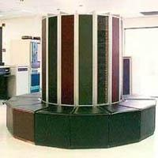
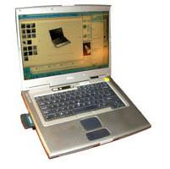
SISD Example Systems

Slide 20
Parallel Computing – Flynn’s Taxonomy
A type of parallel computer
Single Instruction: All processing units execute the same instruction at any given clock cycle
Multiple Data: Each processing unit can operate on a different data element
Best suited for specialized problems characterized by a high degree of regularity, such as graphics/image processing.
All processing units execute the same instruction at any given clock cycle
Each processing unit can operate on a different data element

Slide 21
Parallel Computing – Flynn’s Taxonomy
One instruction stream is broadcast to all processors
Each processor (also called a processing element or PE) is very simplistic and is essentially an ALU;
- PEs do not store a copy of the program nor have a program control unit
All active processor executes the same instruction synchronously, but on different data
On a memory access, all active processors must access the same location in their local memory.
The data items form an array and an instruction can act on the complete array in one cycle.

Slide 22
Parallel Computing – Flynn’s Taxonomy
How to View an SIMD Machine
Think of soldiers all in a unit.
A commander selects certain soldiers as active – for example, every even numbered row.
The commander barks out an order that all the active soldiers should do and they execute the order synchronously.

Slide 23
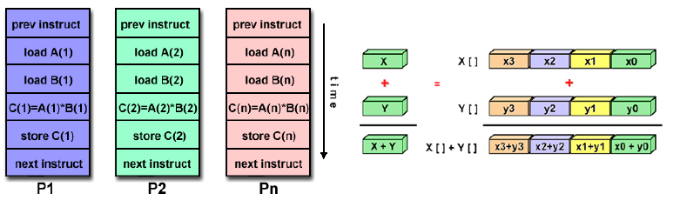
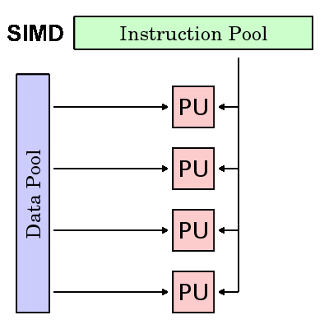
Most modern computers, particularly those with graphics processor units (GPUs) employ SIMD instructions and execution units.
Examples:
Processor Arrays: Thinking Machines CM-2, MasPar MP-1 & MP-2, ILLIAC IV
Vector Pipelines: IBM 9000, Cray X-MP, Y-MP & C90, Fujitsu VP, NEC SX-2, Hitachi S820, ETA10

Slide 24
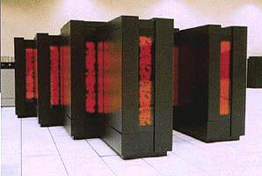
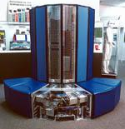
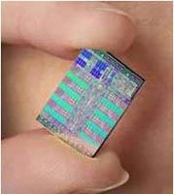
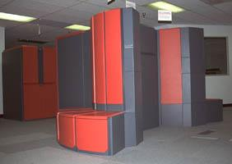
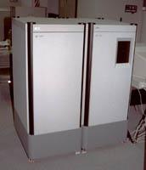
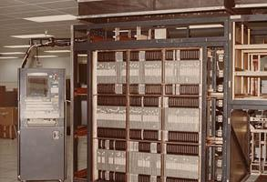
SIMD Example Systems

Slide 25
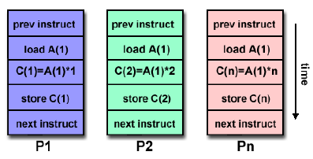
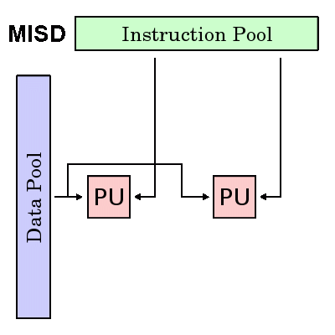
A single data stream is fed into multiple processing units.
Each processing unit operates on the data independently via independent instruction streams.
Multiple Instruction: Each processing unit operates on the data independently via separate instruction streams.
Single Data: A single data stream is fed into multiple processing units.
Few (if any) actual examples of this class of parallel computer have ever existed.

Slide 26
Parallel Computing – Flynn’s Taxonomy
Some conceivable uses might be:
multiple frequency filters operating on a single signal stream
multiple cryptography algorithms attempting to crack a single coded message.
Few actual examples : Carnegie-Mellon C.mmp computer (1971).
Processors are asynchronous, since they can independently execute different programs on different data sets.
Communications are handled either by
through shared memory. (multiprocessors)
use of message passing (multicomputers)
MIMD’s have been considered by most researchers to include the most powerful, least restricted computers.

Slide 27
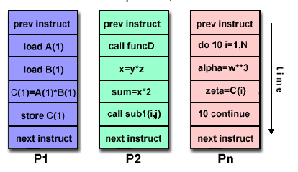
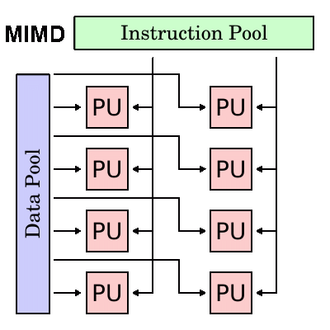
A type of parallel computer
Multiple Instruction: Every processor may be executing a different instruction stream
Multiple Data: Every processor may be working with a different data stream
Currently, most common type of parallel computer
Every processor may be executing a different instruction stream
Every processor may be working with a different data stream
Execution can be synchronous or asynchronous, deterministic or non-deterministic

Slide 28
Parallel Computing – Flynn’s Taxonomy
Currently, the most common type of parallel computer - most modern supercomputers fall into this category.
Examples: most current supercomputers, networked parallel computer clusters and "grids", multi-processor SMP computers, multi-core PCs.
Note: Many MIMD architectures also include SIMD execution sub-components

Slide 29
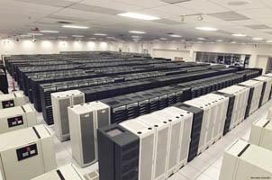
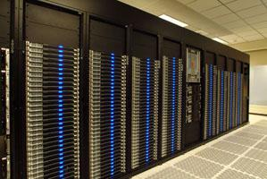
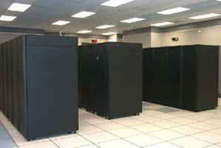
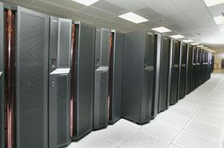
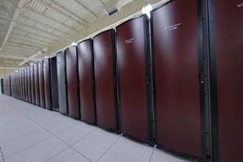
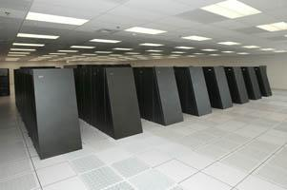
MIMD Example Systems

Slide 30
Parallel Computing – General Parallel Computing Terminology
Like everything else, parallel computing has its own jargon. Some of the more commonly used terms associated with parallel computing are listed below.
CPU
Contemporary CPUs consist of one or more cores - a distinct execution unit with its own instruction stream.
Cores with a CPU may be organized into one or more sockets - each socket with its own distinct memory .
When a CPU consists of two or more sockets, usually hardware infrastructure supports memory sharing across sockets.
Node
A standalone "computer in a box." Usually comprised of multiple CPUs/processors/cores, memory, network interfaces, etc. Nodes are networked together to comprise a supercomputer.

Slide 31
Parallel Computing – General Parallel Computing Terminology
Task
A logically discrete section of computational work.
A task is typically a program or program-like set of instructions that is executed by a processor.
A parallel program consists of multiple tasks running on multiple processors.
Pipelining
Breaking a task into steps performed by different processor units, with inputs streaming through, much like an assembly line; a type of parallel computing.
Shared Memory
Describes a computer architecture where all processors have direct access to common physical memory.
In a programming sense, it describes a model where parallel tasks all have the same "picture" of memory and can directly address and access the same logical memory locations regardless of where the physical memory actually exists.

Slide 32
Parallel Computing – General Parallel Computing Terminology
Symmetric Multi-Processor (SMP)
Shared memory hardware architecture where multiple processors share a single address space and have equal access to all resources - memory, disk, etc.
Distributed Memory
In hardware, refers to network based memory access for physical memory that is not common.
As a programming model, tasks can only logically "see" local machine memory and must use communications to access memory on other machines where other tasks are executing.
Communications
Parallel tasks typically need to exchange data. There are several ways this can be accomplished, such as through a shared memory bus or over a network.

Slide 33
Parallel Computing – General Parallel Computing Terminology
Synchronization
The coordination of parallel tasks in real time, very often associated with communications.
Synchronization usually involves waiting by at least one task, and can therefore cause a parallel application's wall clock execution time to increase.
Computational Granularity
In parallel computing, granularity is a quantitative or qualitative measure of the ratio of computation to communication.
Coarse: relatively large amounts of computational work are done between communication events
Fine: relatively small amounts of computational work are done between communication events

Slide 34

Parallel Computing – General Parallel Computing Terminology
Observed Speedup
Observed speedup of a code which has been parallelized, defined as:
One of the simplest and most widely used indicators for a parallel program's performance.

Slide 35
Parallel Computing – General Parallel Computing Terminology
Parallel Overhead
Required execution time that is unique to parallel tasks, as opposed to that for doing useful work. Parallel overhead can include factors such as:
Task start-up time
Synchronizations
Data communications
Software overhead imposed by parallel languages, libraries, operating system, etc.
Task termination time
Massively Parallel
Refers to the hardware that comprises a given parallel system - having many processing elements.
The meaning of "many" keeps increasing, but currently, the largest parallel computers are comprised of processing elements numbering in the hundreds of thousands to millions.

Slide 36
Parallel Computing – General Parallel Computing Terminology
Embarrassingly (IDEALY) Parallel
Solving many similar, but independent tasks simultaneously; little to no need for coordination between the tasks.
Scalability
Refers to a parallel system's (hardware and/or software) ability to demonstrate a proportionate increase in parallel speedup with the addition of more resources. Factors that contribute to scalability include:
Hardware - particularly memory-cpu bandwidths and network communication properties
Application algorithm
Parallel overhead related
Characteristics of your specific application

Slide 37
Parallel Computing – Parallel Computer Architectures
Shared memory: Shared memory parallel computers vary widely, but generally have in common the ability for all processors to access all memory as global address space.
Multiple processors can operate independently but share the same memory resources.
Changes in a memory location effected by one processor are visible to all other processors.
Historically, shared memory machines have been classified as UMA and NUMA, based upon memory access times.

Slide 38
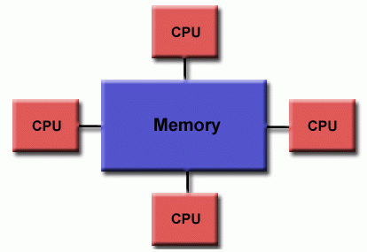
Parallel Computing – Parallel Computer Architectures
Uniform Memory Access (UMA)
Most commonly represented today by Symmetric Multiprocessor (SMP) machines
Identical processors
Equal access and access times to memory
Sometimes called CC-UMA - Cache Coherent UMA.
Cache coherent means if one processor updates a location in shared memory, all the other processors know about the update. Cache coherency is accomplished at the hardware level.

Slide 39
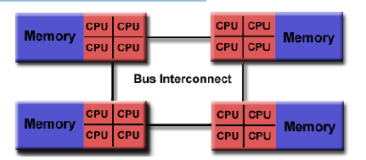
Parallel Computing – Non-uniform memory access (NUMA)
Often made by physically linking two or more SMPs
One SMP can directly access memory of another SMP
Not all processors have equal access time to all memories
Memory access across link is slower
If cache coherency is maintained, then may also be called CC-NUMA - Cache Coherent NUMA
Advantages: -user-friendly programming perspective to memory -fast and uniform data sharing due to the proximity of memory to CPUs
Disadvantages: -lack of scalability between memory and CPUs. -Programmer responsible to ensure "correct" access of global memory -Expense

Slide 40
Parallel Computing - Distributed Memory
Like shared memory systems, distributed memory systems vary widely but share a common characteristic. Distributed memory systems require a communication network to connect inter-processor memory.
Processors have their own local memory. Memory addresses in one processor do not map to another processor, so there is no concept of global address space across all processors.
Because each processor has its own local memory, it operates independently. Changes it makes to its local memory have no effect on the memory of other processors. Hence, the concept of cache coherency does not apply.

Slide 41
Parallel Computing - Distributed Memory
When a processor needs access to data in another processor, it is usually the task of the programmer to explicitly define how and when data is communicated. Synchronization between tasks is likewise the programmer's responsibility.
The network "fabric" used for data transfer varies widely, though it can be as simple as Ethernet.
Advantages: -Memory is scalable with number of processors. -No memory interference or overhead for trying to keep cache coherency. -Cost effective
Disadvantages: -programmer responsible for data communication between processors. -difficult to map existing data structures to this memory organization.

Slide 42
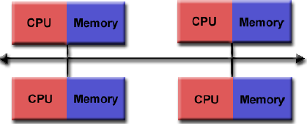
Parallel Computing - Distributed Memory

Slide 43
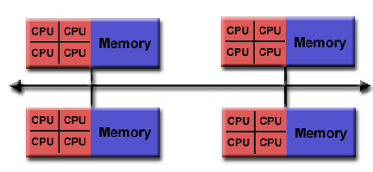
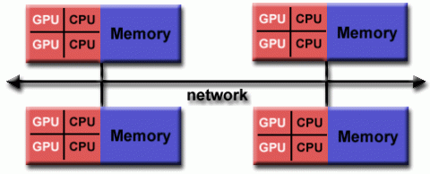
Parallel Computing - Hybrid Distributed-Shared Memory
The largest and fastest computers in the world today employ both shared and distributed memory architectures.

Slide 44
Parallel Computing - Hybrid Distributed-Shared Memory
The shared memory component can be a shared memory machine and/or graphics processing units (GPU).
The distributed memory component is the networking of multiple shared memory/GPU machines, which know only about their own memory - not the memory on another machine. Therefore, network communications are required to move data from one machine to another.
Current trends seem to indicate that this type of memory architecture will continue to prevail and increase at the high end of computing for the foreseeable future.
Advantages and Disadvantages
Whatever is common to both shared and distributed memory architectures.
Increased scalability is an important advantage
Increased programmer complexity is an important disadvantage

Slide 45
Parallel Computing - Advantages
It saves time and money as many resources working together will reduce the time and cut potential costs.
It can be impractical to solve larger problems on Serial Computing
It can take advantage of non-local resources when the local resources are finite.
Reduces the Complexity
Serial Computing ‘wastes’ the potential computing power, thus Parallel Computing makes better work of the hardware.

Slide 46
Parallel Computing – Parallel Programming
Parallel programming (also, unfortunately, sometimes called concurrent programming), is a computer programming technique that provides for the execution of operations concurrently, either
- within a single parallel computer OR
- across a number of systems.
In the latter case, the term distributed computing is used.

Slide 47
Parallel Computing – Parallel Programming Models
Parallel programming models exist as an abstraction above hardware and memory architectures.
Although it might not seem apparent, these models are NOT specific to a particular type of machine or memory architecture. In fact, any of these models can (theoretically) be implemented on any underlying hardware.
There are several parallel programming models in common use:
Shared Memory (without threads)
Threads
Distributed Memory / Message Passing
Data Parallel
Hybrid
Single Program Multiple Data (SPMD)
Multiple Program Multiple Data (MPMD)

Slide 48
Parallel Computing – Shared Model
tasks share a common address space, which they read and write asynchronously.
Various mechanisms such as locks / semaphores may be used to control access to the shared memory.
Advantage:
no need to explicitly communicate of data between tasks -> simplified programming
Disadvantages:
Need to take care when managing memory, avoid synchronization conflicts
Harder to control data locality

Slide 49
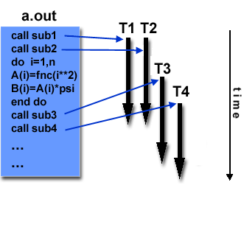
Parallel Computing – Threads
Threads
A thread can be considered as a subroutine in the main program
Threads communicate with each other through the global memory
commonly associated with shared memory architectures and operating systems
PosixThreads or pthreads
OpenMP

Slide 50
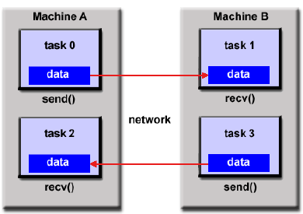
Parallel Computing – Message Passing
A set of tasks that use their own local memory during computation.
Data exchange through sending and receiving messages.
Data transfer usually requires cooperative operations to be performed by each process. For example, a send operation must have a matching receive operation.
MPI (released in 1994)
MPI-2 (released in 1996)

Slide 51
Parallel Computing – Data Parallel Model
May also be referred to as the Partitioned Global Address Space (PGAS) model.
The data parallel model demonstrates the following characteristics:
Most of the parallel work performs operations on a data set, organized into a common structure, such as an array
A set of tasks works collectively on the same data structure, with each task working on a different partition
Tasks perform the same operation on their partition
On shared memory architectures, all tasks may have access to the data structure through global memory. On distributed memory architectures the data structure is split up and resides as "chunks" in the local memory of each task.

Slide 52
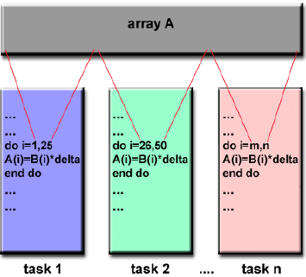
Parallel Computing – Data Parallel Model

Slide 53
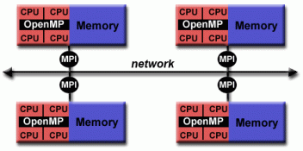
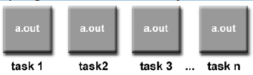
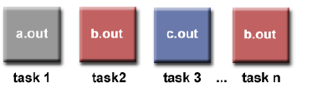
Parallel Computing – Parallel Programming Model
Hybrid
combines various models, e.g., MPI/OpenMP
Single Program Multiple Data (SPMD)
A single program is executed by all tasks simultaneously
Multiple Program Multiple Data (MPMD)
An MPMD application has multiple executables. Each task can execute the same or different program as other tasks.

Slide 54
Parallel Computing – Types
Bit-level parallelism
Instruction-level parallelism
Task Parallelism

Slide 55
Parallel Computing – Types
Bit-level parallelism
Every task is dependent on processor word size. In terms of performing a task on large-sized data, it reduces the number of instructions the processor must execute.
There is a need to split the operation into series of instructions. For example, there is an 8-bit processor, and you want to do an operation on 16-bit numbers. First, it must operate the 8 lower-order bits and then the 8 higher-order bits. Therefore, two instructions are needed to execute the operation. The operation can be performed with one instruction by a 16-bit processor.

Slide 56
Parallel Computing – Types
Instruction-level parallelism
A processor can only address less than one instruction for each clock cycle phase. These instructions can be re-ordered and grouped which are later on executed concurrently without affecting the result of the program. This is called instruction-level parallelism

Slide 57
Parallel Computing – Why?
Historically, parallel computing has been considered to be "the high end of computing," and has been used to model difficult problems in many areas of science and engineering:
Atmosphere, Earth, Environment
Physics - applied, nuclear, particle, condensed matter, high pressure, fusion, photonics
Bioscience, Biotechnology, Genetics
Chemistry, Molecular Sciences
Geology, Seismology
Mechanical Engineering - from prosthetics to spacecraft
Electrical Engineering, Circuit Design, Microelectronics
Computer Science, Mathematics
Defense, Weapons

Slide 58


Parallel Computing – Why?
The Real-World is a Massively Complex
In the natural world, many complex, interrelated events are happening at the same time, yet within a temporal sequence.

Slide 59
Parallel Computing – Why?
The Real-World is a Massively Complex
Compared to serial computing, parallel computing is much better suited for modeling, simulating and understanding complex, real world
phenomena.
For example, imagine modeling these serially:

Slide 60
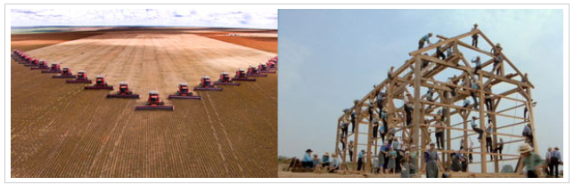
Parallel Computing – Why?
Save Time/Monet
In theory, throwing more resources at a task will shorten its time to completion, with potential cost savings.
Parallel computers can be built from cheap, commodity components.

Slide 61

Parallel Computing – Why?
Solve Larger/Complex Problems
Many problems are so large and/or complex that it is impractical or impossible to solve them using a serial program, especially given limited computer memory.

Slide 62
Parallel Computing – Why?
Solve Larger/Complex Problems
Example: "Grand Challenge Problems" (en.wikipedia.org/wiki/Grand_Challenge) requiring petaflops and petabytes of computing resources.
Example: Web search engines/databases processing millions of transactions every second
Petaflops =
Petabytes =

Slide 63

Parallel Computing – Why?
Provide Accuracy
Single compute resource can only do one thing at a time. Multiple compute resources can do many things simultaneously.
Example: Collaborative Networks provide a global venue where people from around the world can meet and conduct work "virtually".

Slide 64
Parallel Computing – Why?
Provide Accuracy
Single compute resource can only do one thing at a time. Multiple compute resources can do many things simultaneously.
Example: Collaborative Networks provide a global venue where people from around the world can meet and conduct work "virtually".

Slide 65

Parallel Computing – Why?
Take Advantage of non-local Resources
Using compute resources on a wide area network, or even the Internet when local compute resources are scarce or insufficient.
Example: SETI@home (setiathome.berkeley.edu) has over 1.7 million users in nearly every country in the world. (May, 2018).

Slide 66
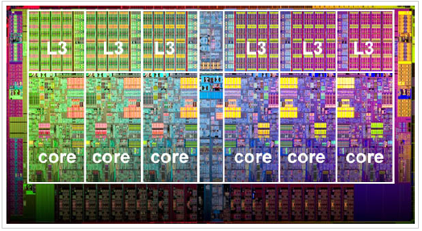
Parallel Computing – Why?
BETTER USE OF UNDERLYING PARALLEL HARDWARE
Modern computers, even laptops, are parallel in architecture with multiple processors/cores.
Parallel software is specifically intended for parallel hardware with multiple cores, threads, etc.
In most cases, serial programs run on modern computers "waste" potential computing power.

Slide 67
Parallel Computing – Who is using?
Science and Engineering
Historically, parallel computing has been considered to be "the high end of computing", and has been used to model difficult problems in many areas of science and engineering:
Atmosphere, Earth, Environment
Physics - applied, nuclear, particle, condensed matter, high pressure, fusion, photonics
Bioscience, Biotechnology, Genetics
Chemistry, Molecular Sciences

Slide 68
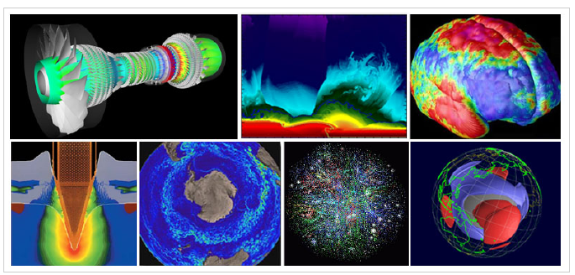
Parallel Computing – Who is using?
Science and Engineering
Geology, Seismology
Mechanical Engineering - from prosthetics to spacecraft
Electrical Engineering, Circuit Design, Microelectronics
Computer Science, Mathematics
Defense, Weapons

Slide 69

Parallel Computing – Who is using?
Industrial and Commercial
• Today, commercial applications provide an equal or greater driving force in the development of faster computers. These applications require
the processing of large amounts of data in sophisticated ways. For example:
"Big Data",data mining
Artificial Intelligence (AI)
Oil exploration

Slide 70
Parallel Computing – Who is using?
Industrial and Commercial
Web search engines, web based business services
Medical imaging and diagnosis
Pharmaceutical design
Financial and economic modeling
Management of national and multi-national corporations
Advanced graphics and virtual reality, particularly in the entertainment industry
Networked video and multi-media technologies
Collaborative work environments

Slide 71

Parallel Computing – Who is using?
Global Applications
Parallel computing is now being used extensively around the world, in a wide variety of applications

Slide 72
Parallel Computing – Limitations
It addresses such as communication and synchronization between multiple sub-tasks and processes which is difficult to achieve.
The algorithms must be managed in such a way that they can be handled in a parallel mechanism.
The algorithms or programs must have low coupling and high cohesion. But it’s difficult to create such programs.
More technically skilled and expert programmers can code a parallelism-based program well.

Slide 74
von Neumann Computer
Model for designing and building computers, based on the following three characteristics:
The computer consists of four main sub-systems:
Memory
ALU (Arithmetic/Logic Unit)
Control Unit
Input/Output System (I/O)
Program is stored in memory during execution.
Program instructions are executed sequentially.

Slide 75
von Neumann Computer
Bus
Memory
Processor (CPU)
Input-Output
Control Unit
ALU
Communicate with
"outside world", e.g.
Screen
Keyboard
Storage devices
...
Store data and program
Execute program
Do arithmetic/logic operations requested by program

Slide 76




von Neumann Computer
All computers more or less based on the same basic design, the Von Neumann Architecture!

Slide 77

Personnel Computer

Slide 78
Motivations for Parallel Computing
Fundamental limits on single processor speed
Heat dissipation from CPU chips
Disparity between CPU & memory speeds
Distributed data communications
Need for very large scale computing platforms

Slide 79
Motivations for Parallel Computing
Fundamental limits – Cycle Speed
- Intel 8080 2MHz 1974
ARM 2 8MHz 1986
Intel Pentium Pro 200MHz 1996
AMD Athlon 1.2GHz 2000
Intel QX6700 2.66GHz 2006
Intel Core i7 3770k 3.9GHz 2013
Speed of light: 30cm in 1ns

Slide 80
Moore’s Law
Moore’s observation in 1965: the number of transistors per square inch on integrated circuits had doubled every year since the integrated circuit was invented
Moore’s revised observation in 1975: the pace was slowed down a bit, but data density had doubled approximately every 18 months
How about the future? (price of computing power falls by a half every 18 months?)

Slide 81

Moore’s Law – Held for Now

Slide 82
Power Wall Effect in Computer Architecture
Too many transistors in a given chip die area
Tremendous increase in power density
Increased chip temperature
High temperature slows down the transistor switching rate and the overall speed of the computer
Chip may melt down if not cooled properly  Efficient cooling systems are expensive

Slide 83

Cooling Computer Chips
Some people suggest to put computer chips in liquid nitrogen to cool them

Slide 84

Solutions
Use multiple inexpensive processors A processor with multiple cores

Slide 85

A Multi-Core Processor

Slide 86
CPU and Memory Speed
In 20 years, CPU speed (clock rate) has increased by a factor of 1000
DRAM speed has increased only by a factor of smaller than 4
How to feed data faster enough to keep CPU busy?
CPU speed: 1-2 ns
DRAM speed: 50-60 ns
Cache: 10 ns

Slide 87

Memory Access and CPU Speed

Slide 88

CPU, Memory and Disk Speed

Slide 89
Possible Solutions
A hierarchy of successively fast memory devices (multilevel caches)
Location of data reference (code)
Efficient programming can be an issue
Parallel systems may provide
1.) larger aggregate cache
2.) higher aggregate bandwidth to the memory system

Slide 91
Parallel Computing – Useful Terms
Concurrent - Events or processes which seem to occur or progress at the same time.
Parallel –Events or processes which occur or progress at the same time
Parallel programming (also, unfortunately, sometimes called concurrent programming), is a computer programming technique that provides for the execution of operations concurrently, either
- within a single parallel computer OR
- across a number of systems.
In the latter case, the term distributed computing is used.

Slide 92
Parallel Computing – Useful Terms
Coupling and Cohesion
In software engineering, coupling is the degree of interdependence between software modules; a measure of how closely connected two routines or modules are; the strength of the relationships between modules
Coupling is usually contrasted with cohesion. Low coupling often correlates with high cohesion, and vice versa. Low coupling is often thought to be a sign of a well-structured computer system and a good design, and when combined with high cohesion, supports the general goals of high readability and maintainability.

Slide 93
Parallel Computing – Useful Terms
FLOPS
Floating-point operations per second, or FLOPS, is the unit of measurement that calculates the performance capability of a supercomputer.
Floating-point operations can only be executed on computers with integrated floating-point registers.
The average computer’s processor performance is measured by megahertz (MHz) units to calculate its clock speed. Since supercomputers are far more capable when it comes to power performance, the method in which performance is calculated must be on a considerably larger scale

Slide 94
Parallel Computing – Useful Terms
FLOPS
One petaFLOPS is equal to 1,000,000,000,000,000 (one quadrillion) FLOPS, or one thousand teraFLOPS
One teraFLOPS is equal to 1,000,000,000,000 (one trillion) FLOPS.

Slide 95
Parallel Computing – Useful Terms
SETI@home
SETI@home ("SETI at home") is a project of the Berkeley SETI Research Center to analyze radio signals, searching for signs of extraterrestrial intelligence. Until March 2020, it was run as an Internet-based public volunteer computing project that employed the BOINC software platform. It is hosted by the Space Sciences Laboratory at the University of California, Berkeley, and is one of many activities undertaken as part of the worldwide SETI effort.

Slide 96

Parallel Computing – Useful Terms
Extraterrestrial intelligence
Extraterrestrial intelligence (often abbreviated ETI) refers to hypothetical intelligent extraterrestrial life (Extraterrestrial life is hypothetical life that may occur outside Earth and which did not originate on Earth.)

Slide 97
Parallel Computing
Parallel computing also helps in faster application processing and task resolution by increasing the available computation power of systems.
The parallel computing principles are used by most supercomputers employ to operate.
The operational scenarios that need massive processing power or computation, generally, parallel processing is commonly used there.

